Slide 1
B⁺-Trees
Same structure as B-trees.
Dictionary pairs are in leaves only. Leaves form a doubly-linked list.
Remaining nodes have following structure:
j a₀ k₁ a₁ k₂ a₂ … k_{j} a_{j}
j = number of keys in node.
a_{i} is a pointer to a subtree.
k_{i} <= smallest key in subtree a_{i} and > largest in a_{i-1}.
Notes:
Non-leaf nodes can now be made smaller than leaf nodes, alternatively, capacity of non-leaf nodes can be made larger. Doubly-linked list useful for serial access in ascending order of key. May be dispensed with. Instead of smallest in right subtree, we may use largest in left or some key in-between.

Slide 2
Example B+-tree
9
5
16 30
1 3
5 6
9
16 17
30 40
➔ index node
➔ leaf/data node
Notes:
Yellow nodes (leaves) have elements; green nodes have keys and pointers. Green nodes are index nodes. Leaf capacity may be different from index-node capacity.

Slide 3
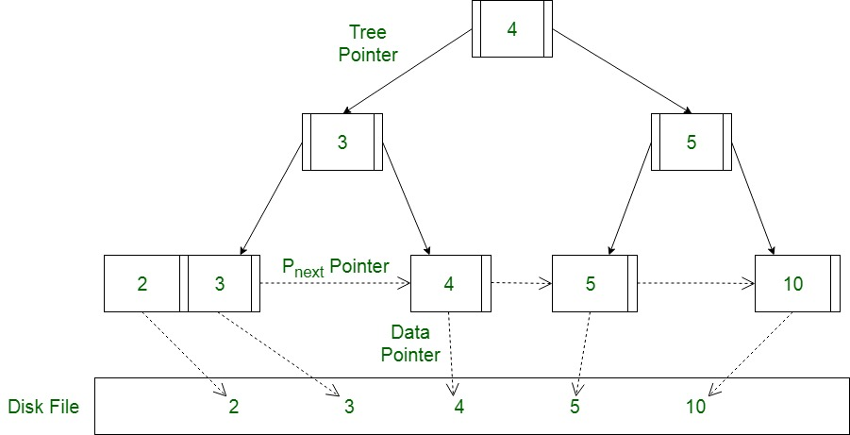
Why B⁺-tree (vs B-tree)?
memory pages hold pointers only so as to maximize the numbers of pointers stored in pages, resulting in reduction of the number of disk pages accessed

Slide 4
B+-tree—Search
9
5
16 30
1 3
5 6
9
16 17
30 40
key = 5
6 <= key <= 20
Notes:
Range search

Slide 5
B+-tree—Insert
9
5
16 30
1
5 6
9
16 17
30 40
Insert 10
Notes:
Note that an insert that does not cause an overflow cannot change any of the index node entries.

Slide 6
Insert
9
5
16 30
1 3
5 6
9
16 17
30 40
Insert a pair with key = 2.
New pair goes into a 3-node.

Slide 7
Insert Into A 3-node
Insert new pair so that the keys are in ascending order.
1 2 3
Split into two nodes.
1
2 3
Insert smallest key in new node and pointer to this new node into parent.
2
1
2 3
Notes:
The code will do all 3 steps as one.

Slide 8
Insert
9
5
2
16 30
2 3
1
5 6
9
16 17
30 40
Insert an index entry 2 plus a pointer into parent.

Slide 9
Insert
9
2 5
16 30
1
2 3
5 6
9
16 17
30 40
Now, insert a pair with key = 18.

Slide 10
Insert
9
17
2 5
16 30
17 18
1
2 3
5 6
9
16
30 40
Now, insert a pair with key = 18.
Insert an index entry17 plus a pointer into parent.
Notes:
Insertion of index entries works as for B-trees.

Slide 11
Insert
9
17
2 5
16
30
1
2 3
5 6
9
16
17 18
30 40
Now, insert a pair with key = 18.
Insert an index entry17 plus a pointer into parent.
Notes:
Insertion of index entries works as for B-trees.

Slide 12
Insert
9 17
2 5
16
30
1
2 3
5 6
9
16
17 18
30 40
Now, insert a pair with key = 7.
Notes:
Yellow splits into 5 & 6,7. Index entry 6 is inserted into parent. Parent splits as in a 2-3 tree, grandparent splits, root splits and height increases by 1.

Slide 13
Delete
9
2 5
16 30
1
2 3
5 6
9
16 17
30 40
Delete pair with key = 16.
Note: delete pair is always in a leaf.

Slide 14
Delete
9
2 5
16 30
1
2 3
5 6
9
17
30 40
Delete pair with key = 16.
Note: delete pair is always in a leaf.

Slide 15
Delete
9
2 5
16 30
1
2 3
5 6
9
17
30 40
Delete pair with key = 1.
Get >= 1 from sibling and update parent key.
Notes:
Note: we may borrow more than 1 pair from sibling; could balance size of deficient node and sibling!

Slide 16
Delete
9
3 5
16 30
2
3
5 6
9
17
30 40
Delete pair with key = 1.
Get >= 1 from sibling and update parent key.

Slide 17
Delete
9
3 5
16 30
2
3
5 6
9
17
30 40
Delete pair with key = 2.
Merge with sibling, delete in-between key in parent.

Slide 18
Delete
9
5
16 30
3
5 6
9
17
30 40
Delete pair with key = 3.
Get >= 1 from sibling and update parent key.

Slide 19
Delete
9
6
16 30
5
6
9
17
30 40
Delete pair with key = 9.
Merge with sibling, delete in-between key in parent.

Slide 20
Delete
9
6
30
17
30 40
5
6

Slide 21
Delete
9
6
16 30
5
6
9
17
30 40
Delete pair with key = 6.
Merge with sibling, delete in-between key in parent.

Slide 22
Delete
9
16 30
5
9
17
30 40
Index node becomes deficient.
Get >= 1 from sibling, move last one to parent, get parent key.

Slide 23
Delete
16
9
30
5
9
17
30 40
Delete 9.
Merge with sibling, delete in-between key in parent.

Slide 24
Delete
16
30
5
17
30 40
Index node becomes deficient.
Merge with sibling and in-between key in parent.
Notes:
Note merge of index nodes is different from merge of data nodes.

Slide 25
Delete
16 30
5
17
30 40
Index node becomes deficient.
It’s the root; discard.

Slide 26
B*-Trees
Root has between 2 and 2 * floor((2m – 2)/3) + 1 children.
Remaining nodes have between ceil((2m – 1)/3) and m children.
All external/failure nodes are on the same level.
Notes:
For m = 3, 4, 5 the lower bound is the same as for B-trees. At m = 6, D-tree allows nodes with degree 3 but B* needs degree 4.

Slide 27
Insert
When insert node is overfull, check adjacent sibling.
If adjacent sibling is not full, move a dictionary pair from overfull node, via parent, to nonfull adjacent sibling.
If adjacent sibling is full, split overfull node, adjacent full node, and in-between pair from parent to get three nodes with floor((2m – 2)/3), floor((2m – 1)/3), floor(2m/3) pairs plus two additional pairs for insertion into parent.

Slide 28
Delete
When combining, must combine 3 adjacent nodes and 2 in-between pairs from parent.
  Total # pairs involved = 2 * floor((2m-2)/3) + [floor((2m-2)/3) – 1] + 2.
  Equals 3 * floor((2m-2)/3) + 1.
Combining yields 2 nodes and a pair that is to be inserted into the parent.
  m mod 3 = 0 => nodes have m – 1 pairs each.
  m mod 3 = 1 => one node has m – 1 pairs and the other has m – 2.
  m mod 3 = 2 => nodes have m – 2 pairs each.
Notes:
Search time is improved. Insert and delete time is worse.

